Slide 1
How to Program an HT with Chirp
By Patrick Hall
KO4HEX

Slide 2

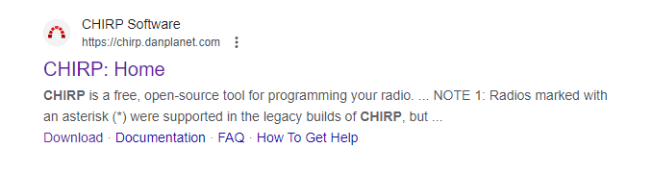
Navigate to Chirp webpage:
Go to Google.com
Search Chirp
Find the chirp.danplanet.com link

Slide 3
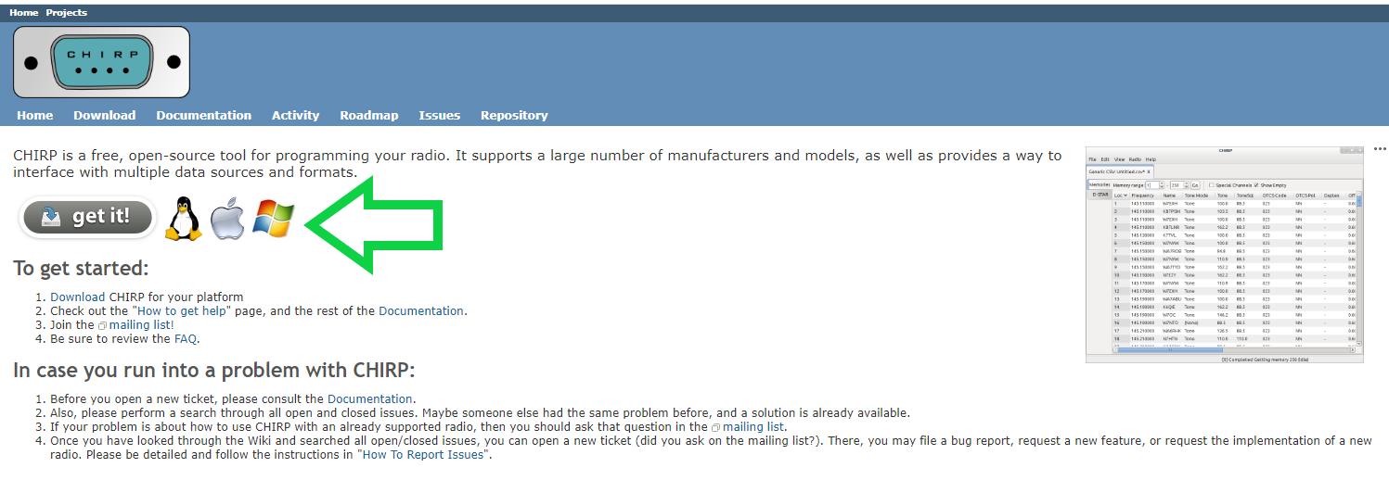
Select “get it!”

Slide 4
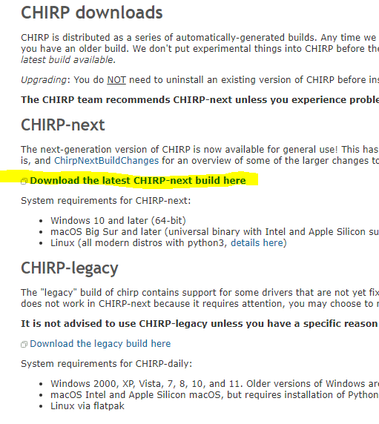
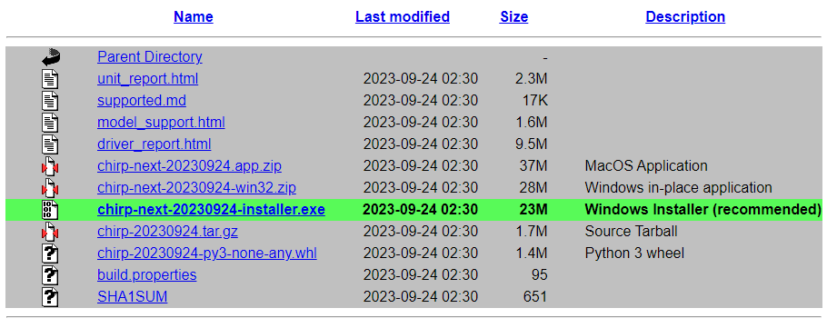

Slide 5
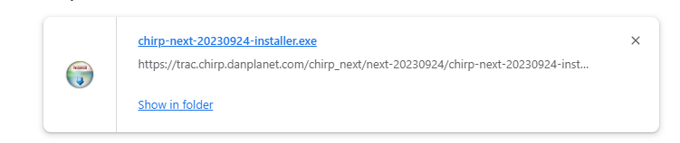
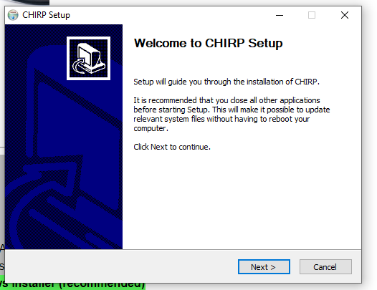
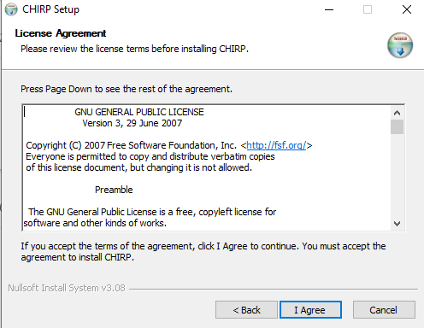
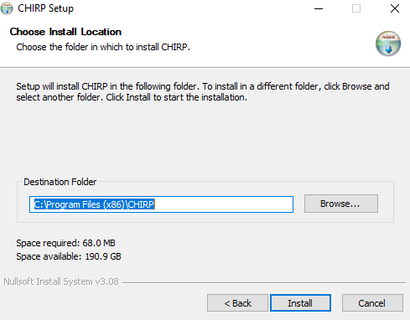
Navigate to your downloads and follow the prompts to install

Slide 6
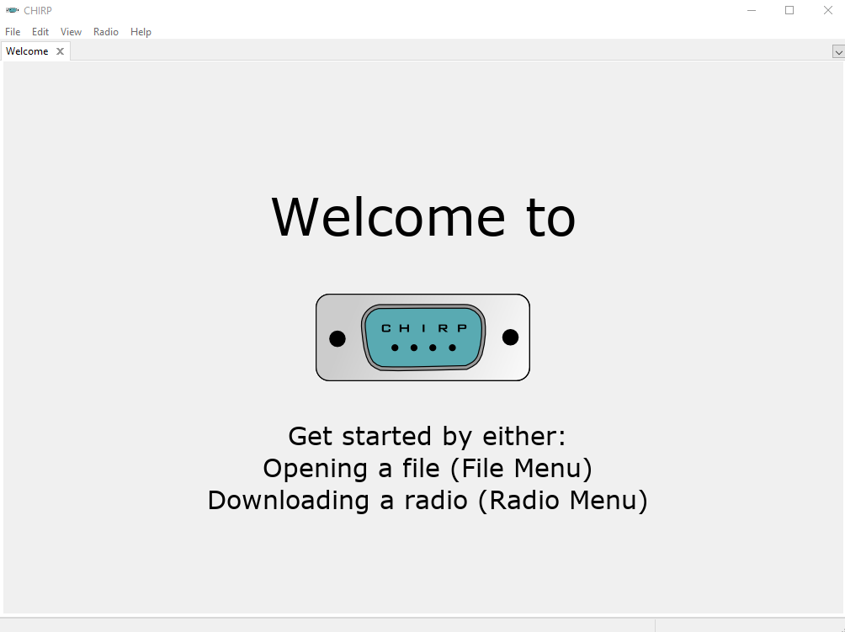

Slide 7

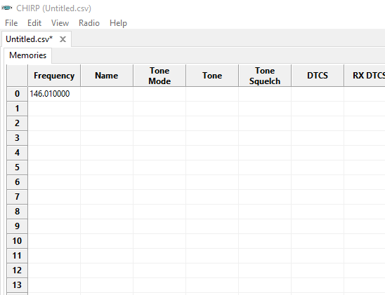

File - New:
This is opening a new “file”
For the purpose of this presentation, I will leave it as “Untitled.csv”
I will also remove the information in the first row that auto populated as 146.01 as this is not needed.
We will customize this file to upload to the radio

Slide 8
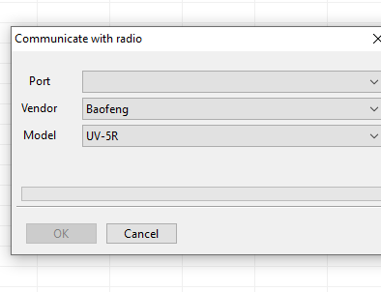
Radio - Download From Radio
Hook up your radio to a computer with a program cable
Find the correct port
Select your “vendor”
Select your radio then click “ok”
This will put any information from your radio on to the computer in the file that you can edit

Slide 9
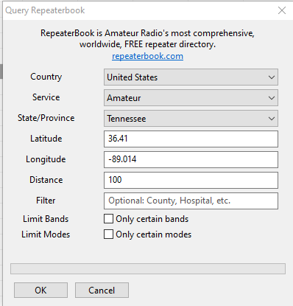

Radio – Query Source – Repeater Book
This will query the repeaterbook website and download the repeaters based on what you put in this query.
It is an easy way to “mass download” repeaters to not input them manually.

Slide 10
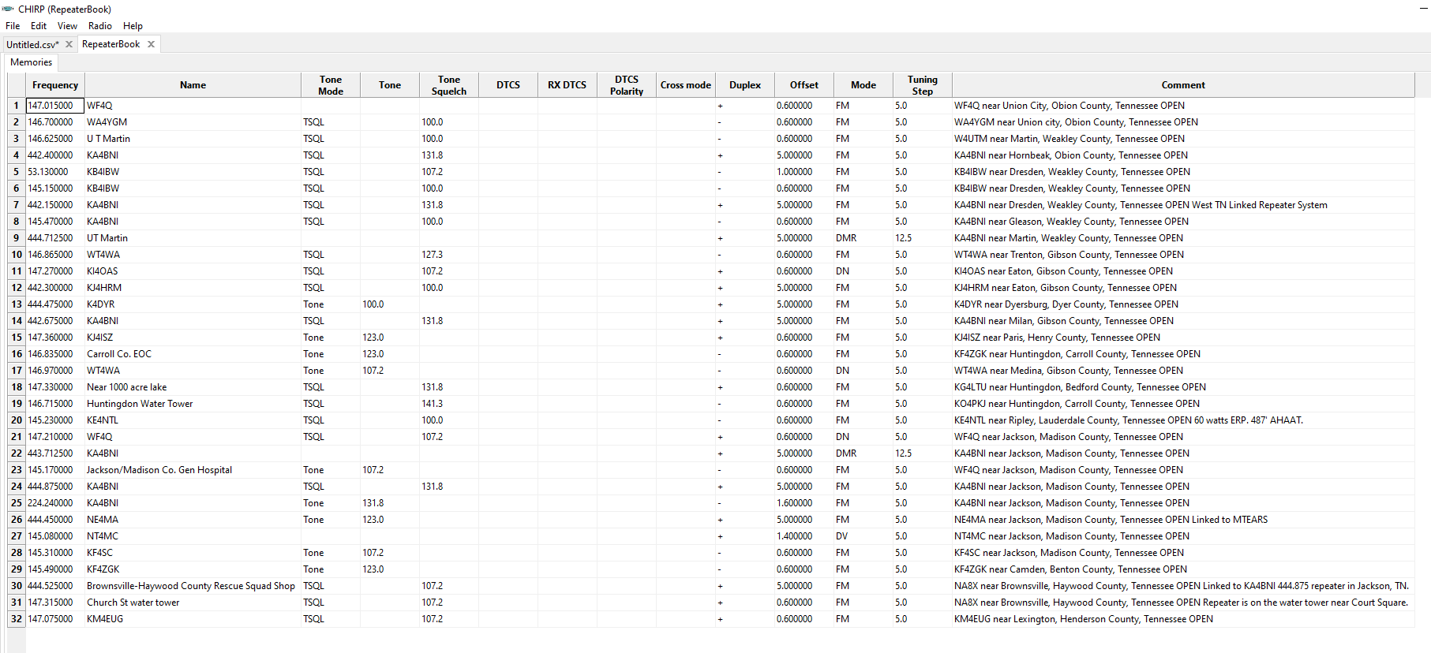
RepeaterBook Query
Results from the previous Query

Slide 11
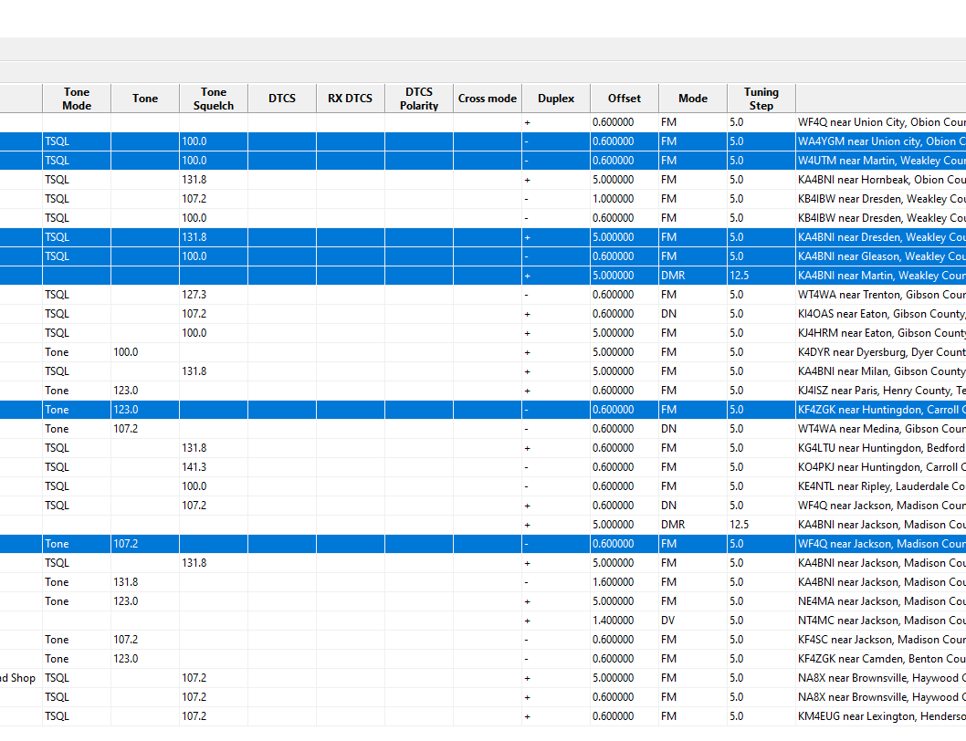
Copy the repeaters you want with Ctrl Click, Then paste in new tab “untitled.csv”
You may use Ctrl click to select individual rows or Shift click to select a range of rows
You can also combine Shift click and Ctrl click – just be careful to use the right one in the right situation or you will end up selecting thing you don’t want
Copy either Ctrl +C or right click and “Copy”

Slide 12
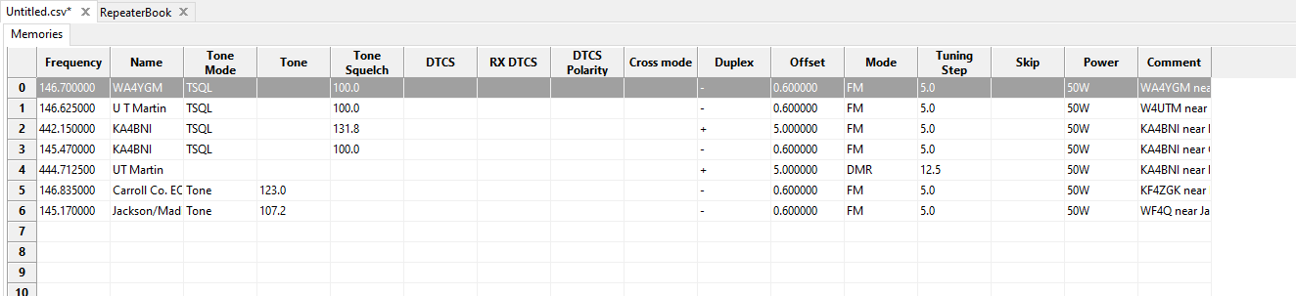
View of “untitled.csv” after pasting selected repeaters from previous slide
Note: I did remove the first entry 146.01 from the “untitled.csv” file before I pasted these entries in.

Slide 13
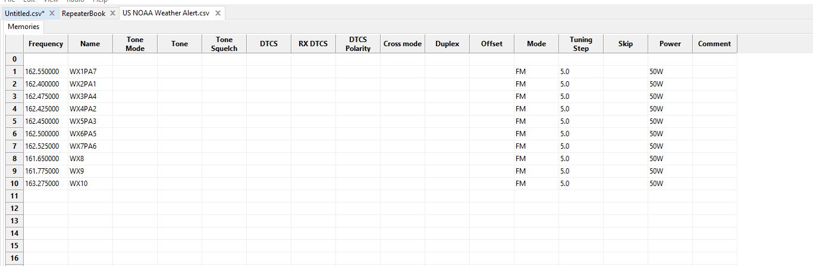
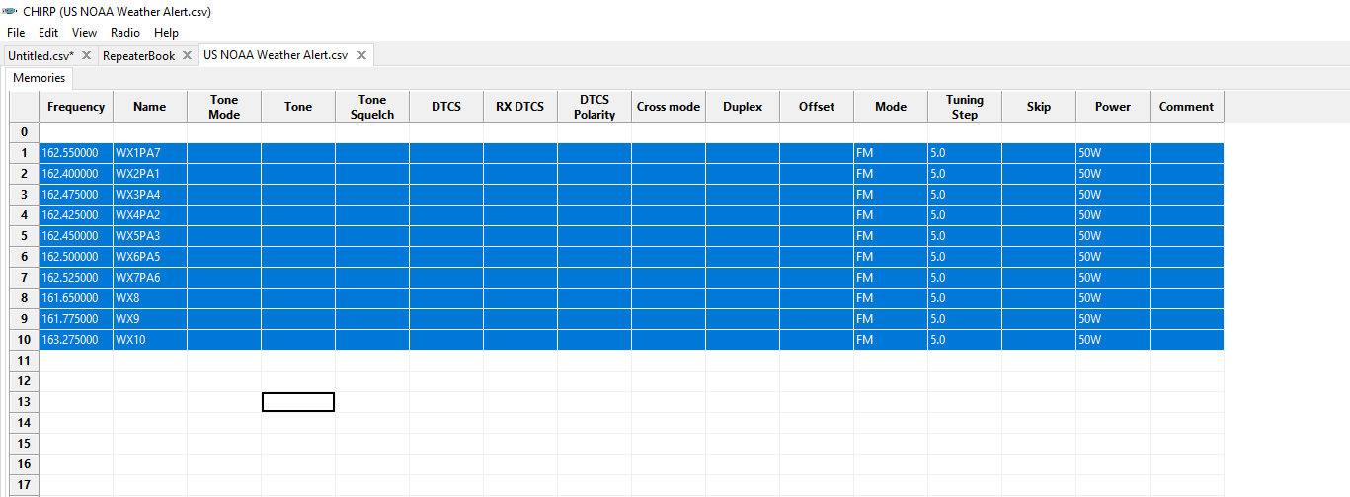
File – Open Stock Config – US NOAA Weather
Importing NOAA WX then copying the stations

Slide 14
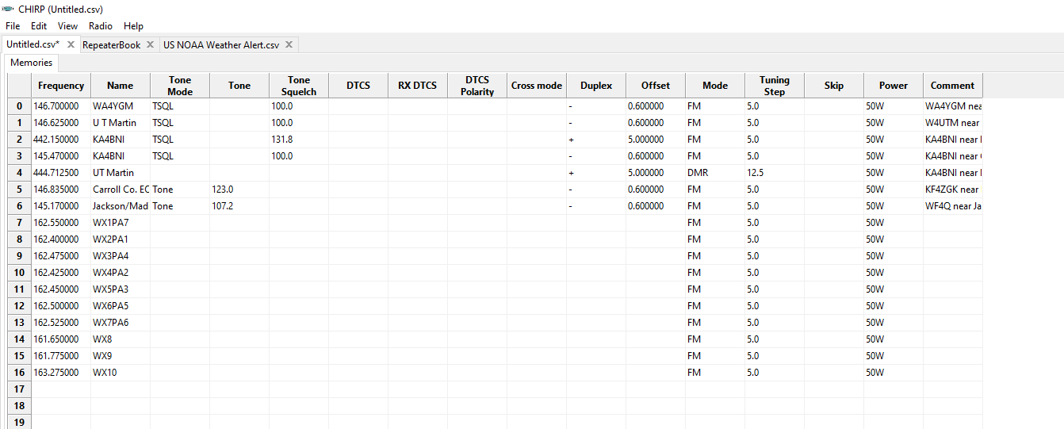
Updated file(Untitled.csv)with NOAA, and Proxy Search

Slide 15
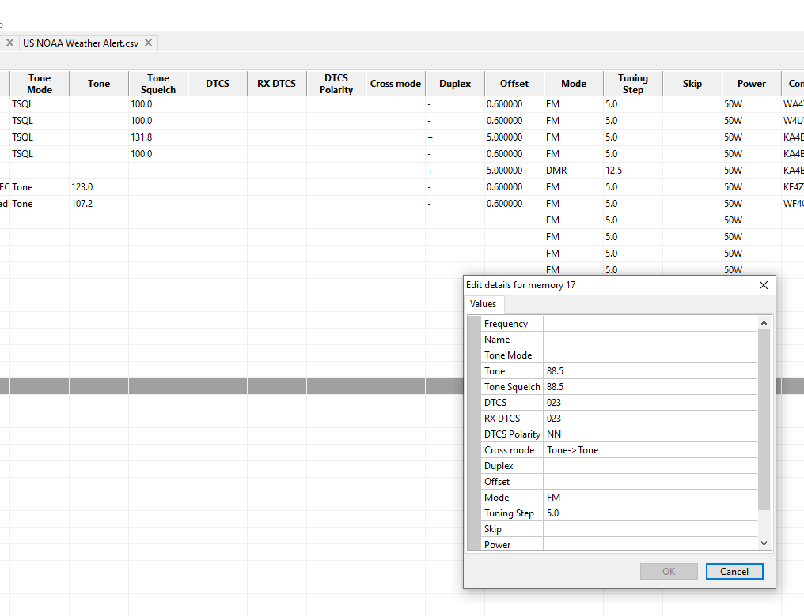
Right click cell – properties – edit cell
You can select multiple channels at once. I did this for the next slide.
This will allow you to edit several fields at once for multiple rows
This is also where you can manually enter in repeaters

Slide 16
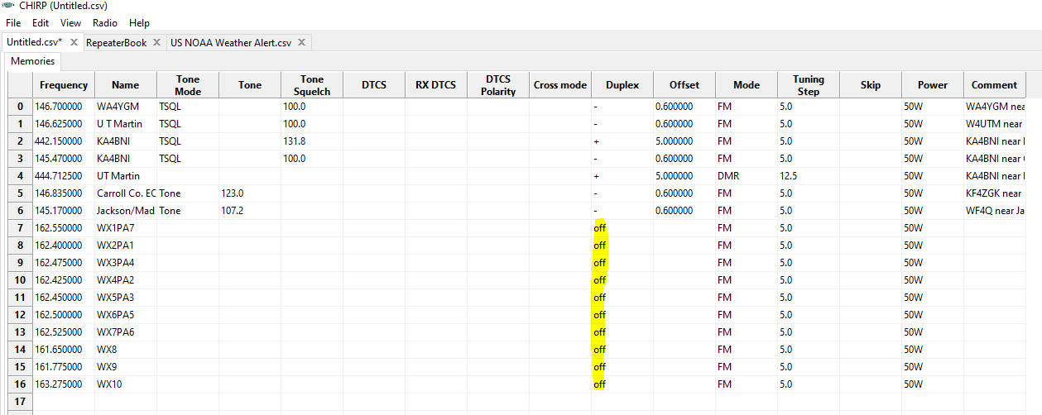
Tip: selected multiple WX rows to turn Duplex OFF. This prevents transmit on unwanted channels

Slide 17

Upload to Radio!
Plug your radio into the computer with the programming cable
Turn your radio on
Go to Radio-Upload to Radio
Get on the Air!!

